Slide 1


Slide 1
NodeJS
Train

Slide 2
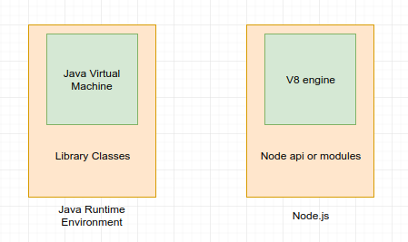
Slide 2
What is nodeJS?
Node.js uses an event-driven, non-blocking I/O model that makes it lightweight and efficient.
Train
2

Slide 3
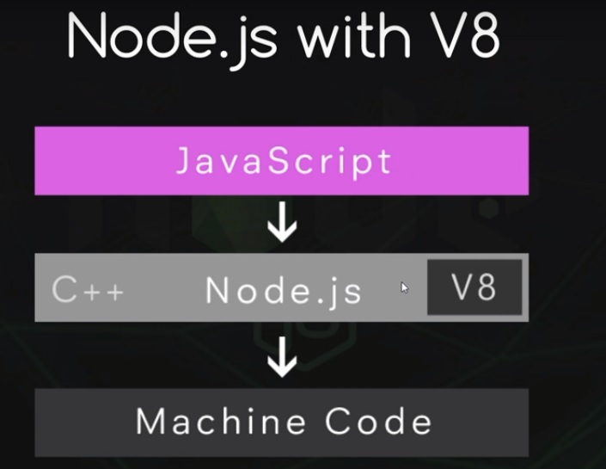
Slide 3
Scripts to be added
Both your browser JavaScript and Node.js run on the V8 JavaScript runtime engine.
This engine takes your JavaScript code and converts it into a faster machine code.
Machine code is low-level code which the computer can run without needing to first interpret it.
Train

Slide 4
Slide 12
null vs empty in array & Object keys and values
null does not contain any value
empty – array position is empty
Object.keys and Object.values
Eg:
>a={a:1,b:2}
>Object.values(a)
>[1, 2]
>Object.keys(a)
>["a", "b"]
Train

Slide 5
Slide 12
Callback Function
A callback function is a function that is passed as an argument to another function, to be “called back” at a later time.
Eg:
setTimeOut
setTimeInterval
clearInterval
Train

Slide 6
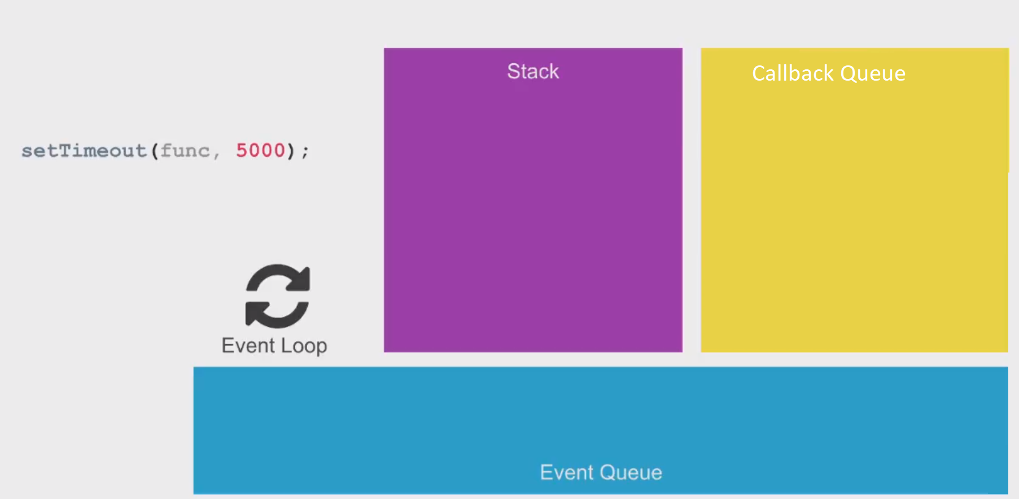
Slide 12
Callback and Event Loop
Web API/API
Train

Slide 7
Slide 12
Callback and Event Loop
Web API/API
setTimeOut
Train

Slide 8
Slide 12
Callback and Event Loop
Web API/API
setTimeOut
Train

Slide 9
Slide 12
Callback and Event Loop
Web API/API
func
Train

Slide 10
Slide 12
Callback Hell
setTimeout(function(){console.log("Callback Hell1")},
setTimeout(function(){console.log("Callback Hell2")},
setTimeout(function(){console.log("Callback Hell3")},
setTimeout(function(){console.log("Callback Hell4")},3000)
,5000)
,0)
,4000)
Web API/API
Train

Slide 11
Slide 12
Callback Hell
setTimeout(function(){console.log("Callback Hell1")},
setTimeout(function(){console.log("Callback Hell2")},
setTimeout(function(){console.log("Callback Hell3")},
setTimeout(function(){console.log("Callback Hell4")},3000)
,5000)
,0)
,4000)
Web API/API
Callback hell4
Callback hell3
Callback hell2
Callback hell1
Train

Slide 12
Slide 12
Callback Hell
setTimeout(function(){console.log("Callback Hell1")},
setTimeout(function(){console.log("Callback Hell2")},
setTimeout(function(){console.log("Callback Hell3")},
setTimeout(function(){console.log("Callback Hell4")},3000)
,5000)
,0)
,4000)
Web API/API
Callback hell4
Callback hell3
Callback hell2
Callback hell1
Train

Slide 13
Slide 12
Callback Hell
setTimeout(function(){console.log("Callback Hell1")},
setTimeout(function(){console.log("Callback Hell2")},
setTimeout(function(){console.log("Callback Hell3")},
setTimeout(function(){console.log("Callback Hell4")},3000)
,5000)
,0)
,4000)
Web API/API
Callback hell3
Callback hell2
Callback hell1
Callback hell4
Train

Slide 14
Slide 12
Callback Hell
setTimeout(function(){console.log("Callback Hell1")},
setTimeout(function(){console.log("Callback Hell2")},
setTimeout(function(){console.log("Callback Hell3")},
setTimeout(function(){console.log("Callback Hell4")},3000)
,5000)
,0)
,4000)
Web API/API
Callback hell3
Callback hell2
Callback hell1
Callback hell4
Train

Slide 15
Slide 12
Callback Hell
setTimeout(function(){console.log("Callback Hell1")},
setTimeout(function(){console.log("Callback Hell2")},
setTimeout(function(){console.log("Callback Hell3")},
setTimeout(function(){console.log("Callback Hell4")},3000)
,5000)
,0)
,4000)
Web API/API
Callback hell2
Callback hell1
Callback hell4
Callback hell3
Train

Slide 16
Slide 12
Callback Hell
setTimeout(function(){console.log("Callback Hell1")},
setTimeout(function(){console.log("Callback Hell2")},
setTimeout(function(){console.log("Callback Hell3")},
setTimeout(function(){console.log("Callback Hell4")},3000)
,5000)
,0)
,4000)
Web API/API
Callback hell1
Callback hell4
Callback hell3
Callback hell2
Train

Slide 17
Slide 12
NPM – Node Package Manager
npm i/npm install – Installs all node modules in the package.json
npm install <module> - Installs the modules locally
npm install --save <module>/ npm install -s <module> - Installs the module locally and saves the dependency in package.json
npm install --global <module> - Installs module globally
npm init – creates a new node js project
npm start - runs the start script in the package.json
Train

Slide 18

Slide 11
Assignment Time
Train

